Slide 1
U18EEP8701: Project Phase – II
 |  | Viva –Voce Examination
Project Title | : | RESIDENTIAL ENERGY MANAGEMENT SYSTEM WITH ML-BASED DEMAND PREDICTION AND THEFT DETECTION
SDG Goals | : | 12. Responsible consumption and production
Review Date | : | 15.04.2024
Section and Batch Number | : | BATCH 13
Project Members | : | Abilesh K S – 20BEE001 Brian Maurish J – 20BEE022 Naresh B – 20BEE215
Project Supervisor | : | Mrs. Maithili P, AP II

Slide 2
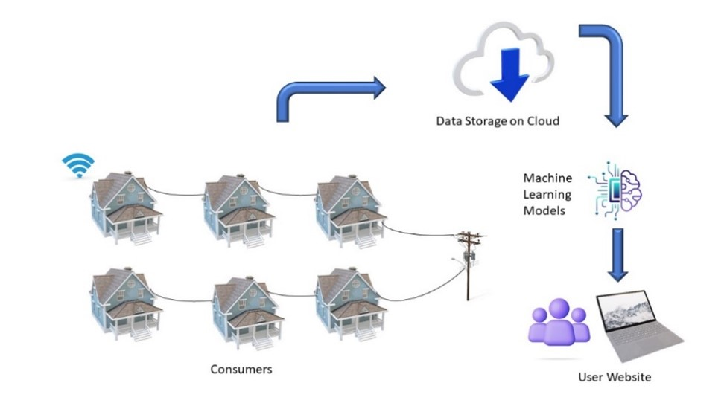
Objective of the Project work
To monitor the energy consumption of the residential building.
To optimize the usage through accurate demand prediction and safeguarding against theft using AIML.
To contribute sustainable energy practices, cost savings, and improved overall energy security.

Slide 3
Introduction
The current state of energy management lacks a comprehensive solution for real-time monitoring, theft detection, and demand prediction.
Existing systems struggle to integrate diverse data sources and provide actionable insights for efficient resource planning.
Energy theft further poses a significant challenge, requiring robust algorithms to identify anomalies in consumption patterns. The absence of a unified platform for secure data compilation and user-friendly visualization hampers effective decision-making.
Thus, there is a critical need for an integrated energy management system that addresses these challenges, offering a holistic approach to monitoring, prediction, and theft detection while ensuring data integrity and user accessibility.

Slide 4
Literature Survey
Literature No. | Paper Title | Authors | Journal Name | Year | Inference
[1] | Energy consumption prediction by using machine learning for smart building: Case study in Malaysia | Mel Keytingan M. Shapi a, Nor Azuana Ramlib, Lilik J. Awalin c | ScienceDirect Journal | 2021 | Cloud-based predictive model development has its advantage as it does not depend on the performance of the hardware it is running on. SVM predicted demand also had better accuracy when average consumption was calculated from the demand.
[2] | Detection of Energy Theft in Smart Grids using Electricity Consumption Patterns | Dabeeruddin Syed, Haitham Abu-Rub, Shady S.Refaat and Le Xie | IEEE International Conference on Big Data (Big Data) | 2020 | The proposed LSTM-based energy theft detection model has benefits of long-term memorization. The proposed LSTM-based methodology with an overall accuracy of 92.69% outperforms the existing Models.
[3] | Enhancing smart grids with a new IOT and cloud-based smart meter to predict the energy consumption with time series | Mehmet Güçyetmez a,b, Husham Sakeen Farhan b,c | ScienceDirect Journal | 2023 | The developed device can monitor the energy consumed by customers, send consumption information to a database, display it to the user instantly via web and mobile applications, enable the user to determine the monetary amount of monthly consumption and track the amount spent.

Slide 5
Concept of proposed work
Real-Time Monitoring: AC sensors track energy usage in real-time, generating data for analysis and management.
Precise Demand Prediction: LSTM neural networks forecast energy demand accurately, aiding in proactive resource planning.
Theft Detection: SVM algorithms identify energy theft by distinguishing normal usage from suspicious patterns.
Data Integrity: Information is securely uploaded to ThingSpeak, ensuring reliability and accessibility.
User Engagement: A user-friendly web app visualizes energy usage and alerts, empowering informed decisions and combating theft.

Slide 6
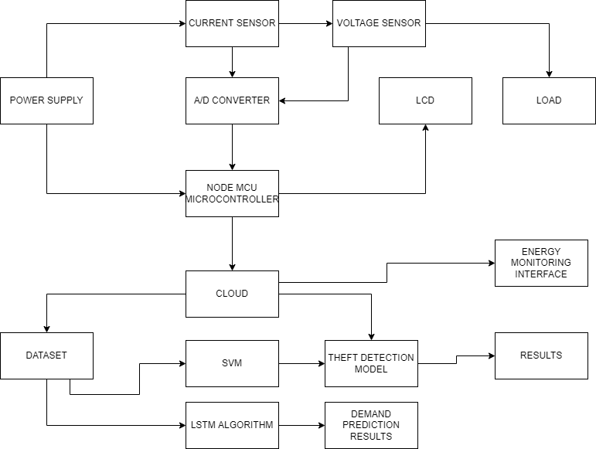
Block Diagram of proposed work

Slide 7
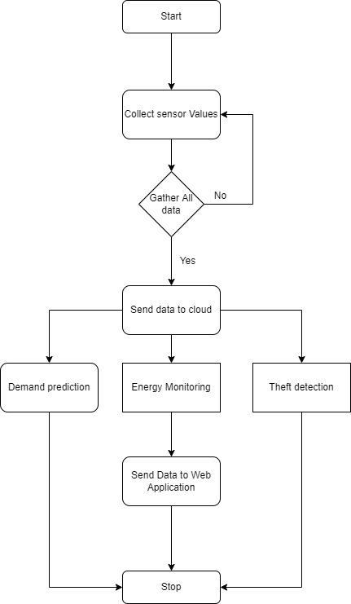
Flowchart of proposed work

Slide 8
Algorithm of proposed work
STEP 1. Collect historical power consumption data from the cloud.
STEP 2. Data Cleaning by normalizing and feature extraction.
STEP 3. Label data with instances of theft and non-theft.
STEP 4. Split data into training and testing sets.
STEP 5. Design and train an SVM classifier:
a. Define the SVM model with the appropriate kernel.
b. Train the model on the training data.
c. Detect potential energy theft by classifying test data.
STEP 7. If theft is detected:
a. Raise an alert for further investigation.
STEP 8. Wait for new data or a predefined interval.
STEP 9. Design and train the LSTM Classifier Model:
a. Define the LSTM model with the appropriate kernel.
b. Train the model on the training data.
c. Predict the future energy demand for the given period.
STEP 10. Display the Theft and Demand prediction model results on Web Application.

Slide 9
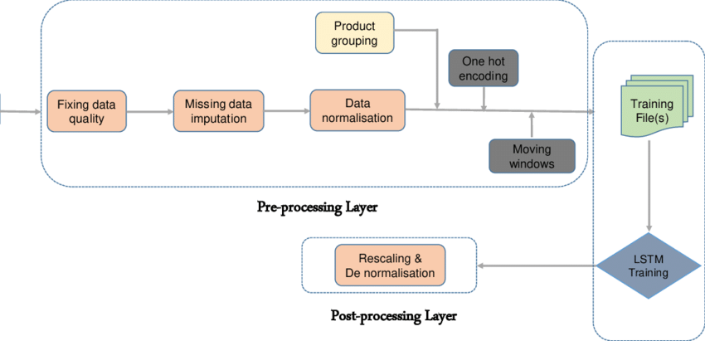
Demand Prediction Model
Sequential Data Mastery: LSTMs, a form of RNN, excel in understanding sequential data, making them ideal for tasks like demand prediction.
Long-Term Dependency Handling: Their unique architecture allows them to capture long-term dependencies, crucial for recognizing complex patterns and trends in demand data.
Adaptability and Accuracy: LSTMs can selectively remember and forget information, contributing to robust demand predictions and improved business operations.

Slide 10
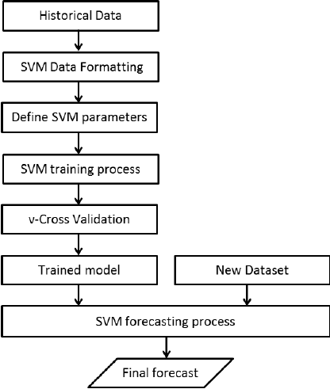
Theft Detection Model
Binary Classification Proficiency: SVMs excel in distinguishing between normal energy usage and anomalous behaviors associated with theft, making them effective for detection tasks.
Efficient Handling of High-Dimensional Data: SVMs efficiently analyze diverse and complex features related to energy consumption, crucial for accurate theft detection.
Robust Anomaly Detection: SVMs' robustness and generalization capabilities ensure reliable detection of anomalies, even amidst noise or variations in consumption patterns.

Slide 11
Implementation of proposed work: Tools & Specifications
HARDWARE COMPONENTS :
S.No | Component | Model | Voltage | Current
1. | Node MCU | ESP8266 | 5 V | -
2. | Voltage Sensor | ZMPT101B | 5 V | -
3. | Current Sensor | ZHT103 |  | 20 A
4. | LCD I2C | 16 X 2 Display
5. | Relay |  | 5 V
6. | ADC Converter - 10 bit ADC | MCP 3008 | 5 V
SOFTWARE TOOLS :
Arduino IDE, ThingSpeak, Google Collab, Thonny Python, VS Code – Web Development

Slide 12
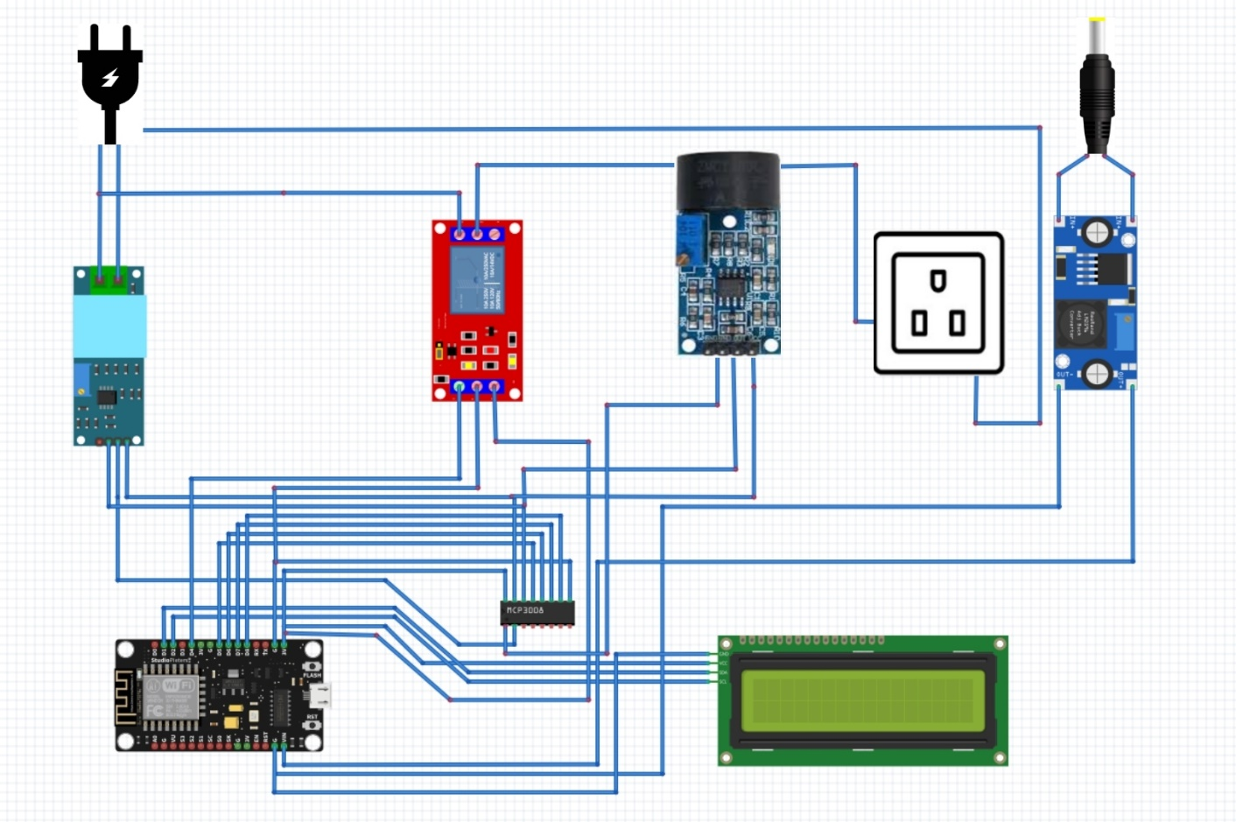
Circuit Diagram of proposed work
PROTOTYPE CIRCUIT CONNECTION :
CURRENT SENSOR
ZHT103
5V RELAY
BUCK CONVERTER
VOLTAGE SENSOR
ZMPT101B
MCP3008
NODEMCU
ESP8266
16X2 LCD DISPLAY

Slide 13
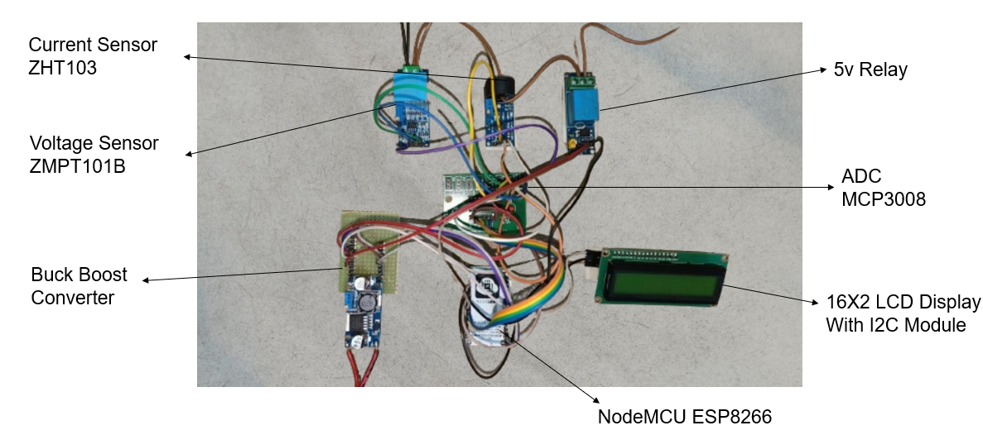
Implementation of proposed work
HARDWARE CIRCUIT CONNECTION :

Slide 14
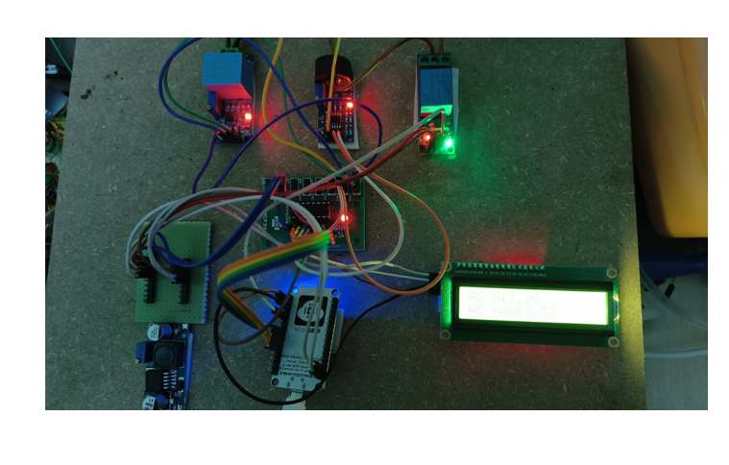
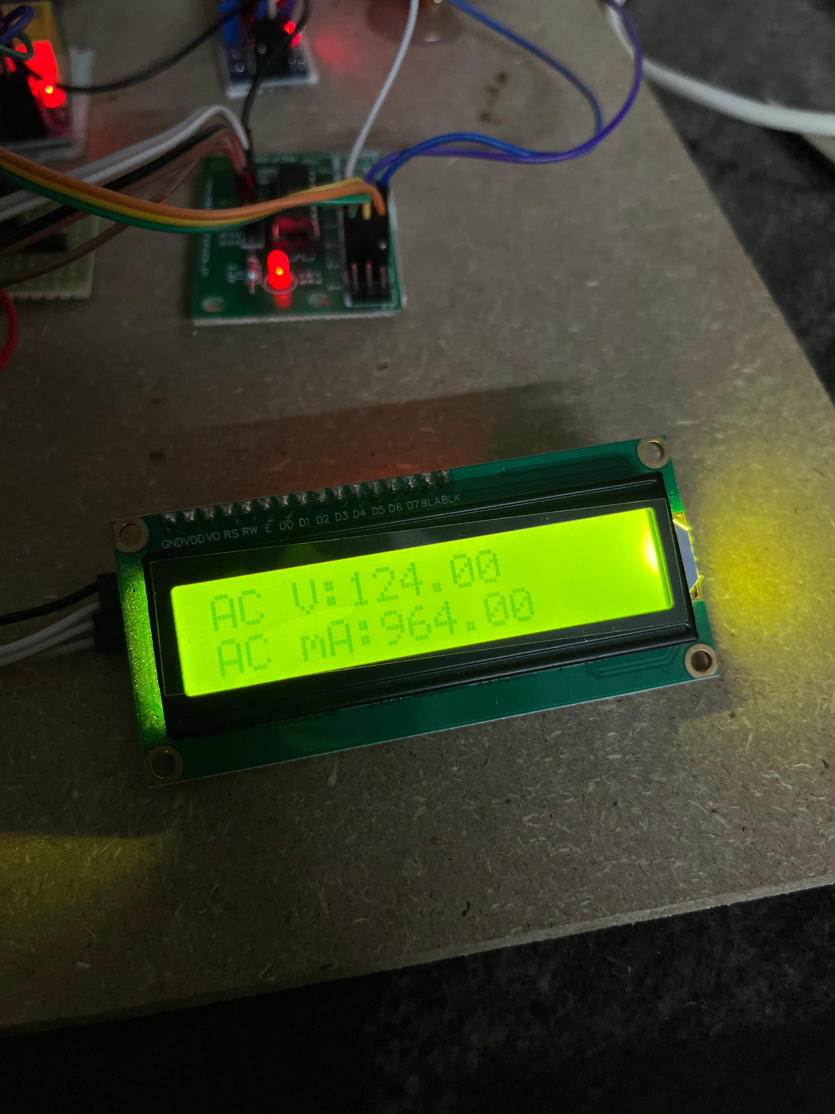
Hardware Setup of proposed work
HARDWARE MODEL WORKING :

Slide 15
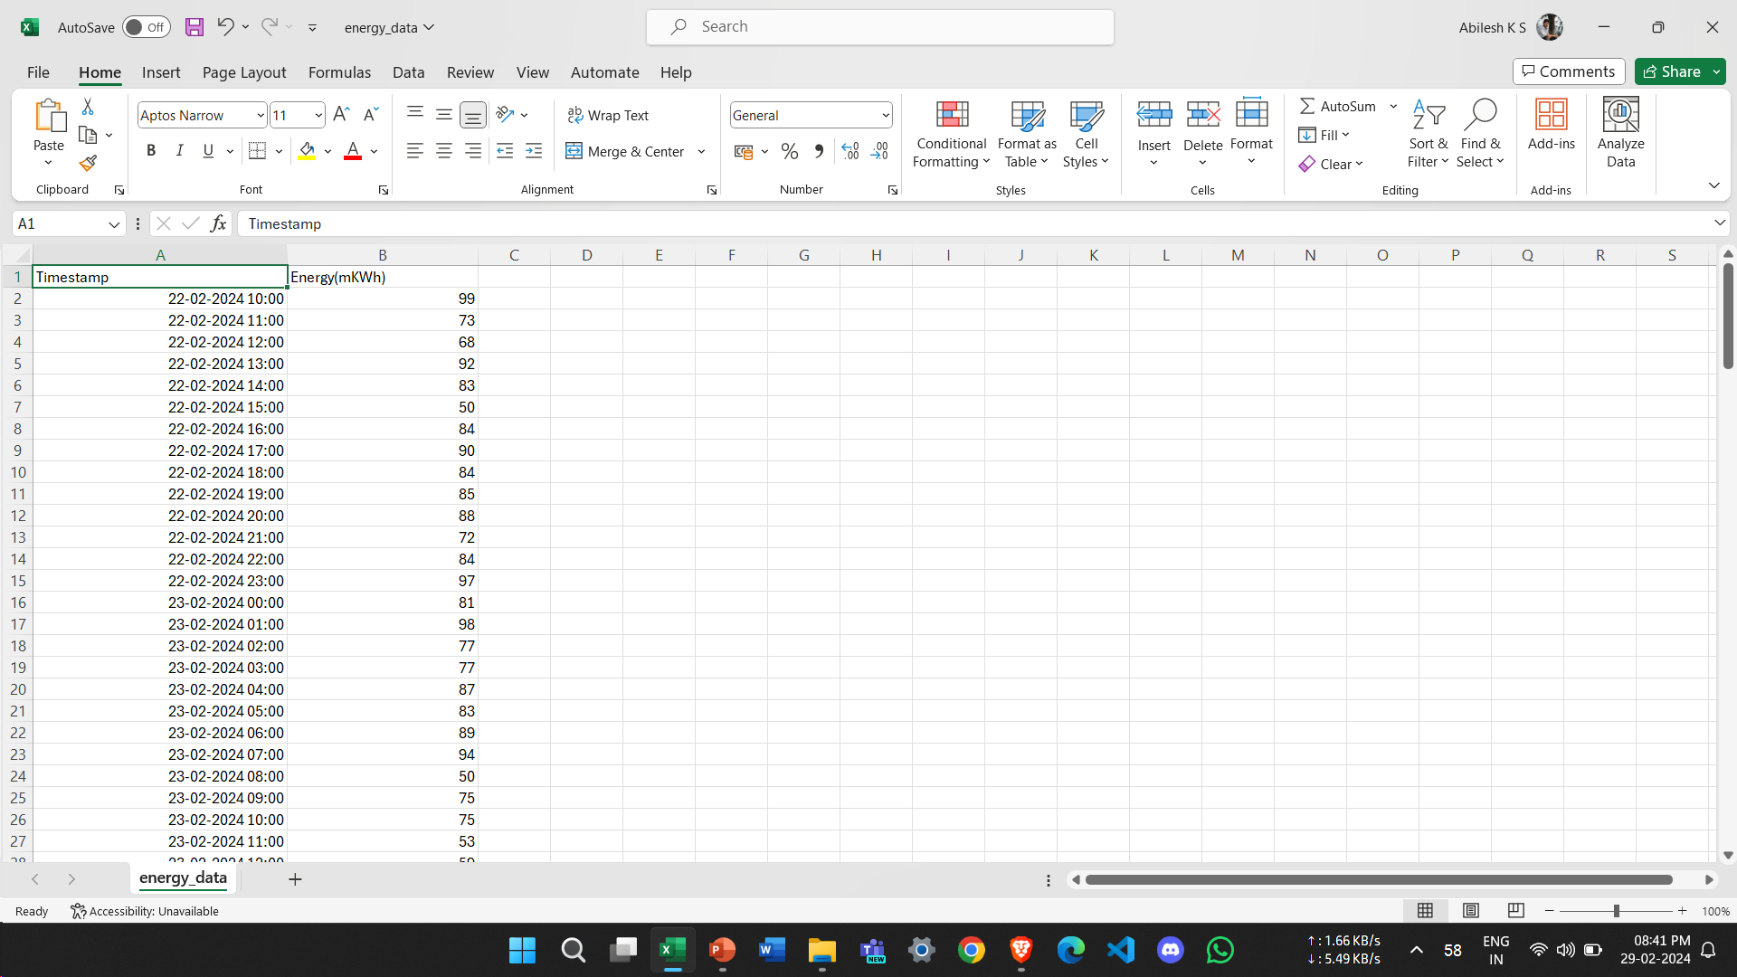

Hardware Results
DATA COLLECTION FROM THINGSPEAK :

Slide 16
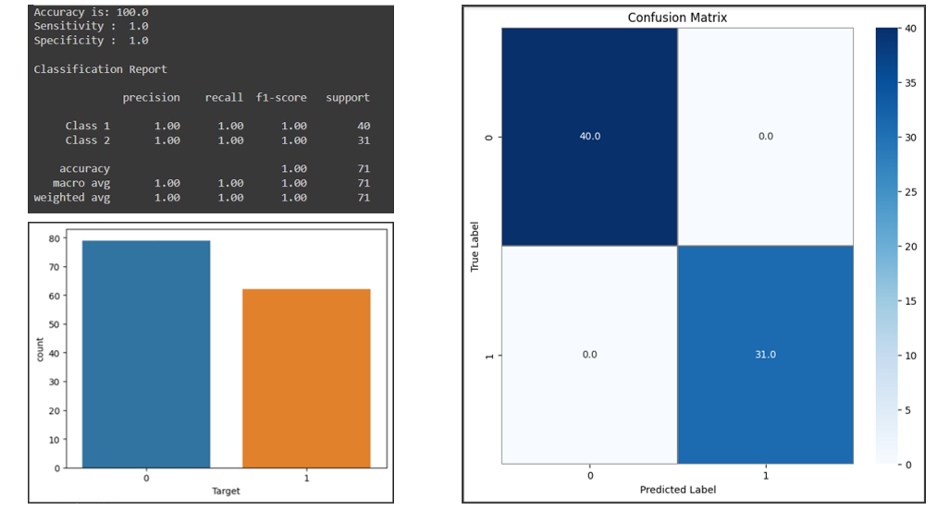
Numerical tabulation of Results
EVALUATION OF THEFT DETECTION MODEL :

Slide 17
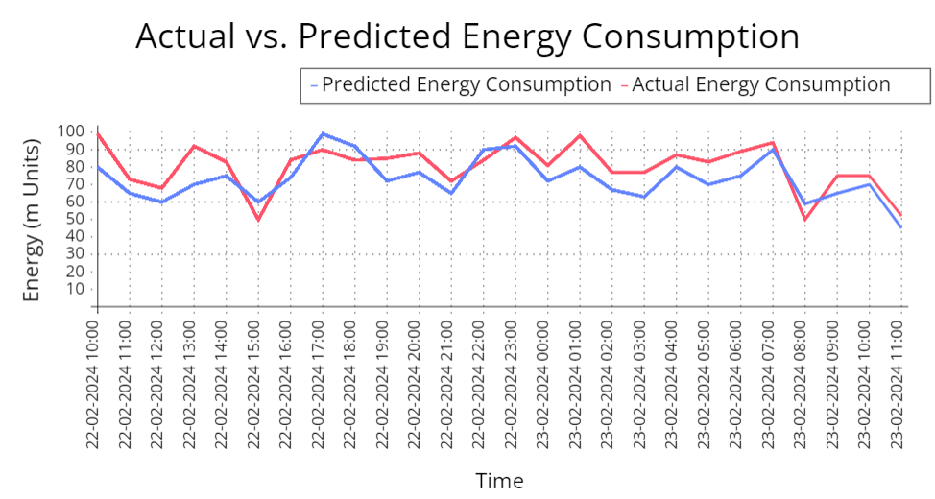
Numerical tabulation of Results
DEMAND PREDICTION MODEL RESULTS :

Slide 18
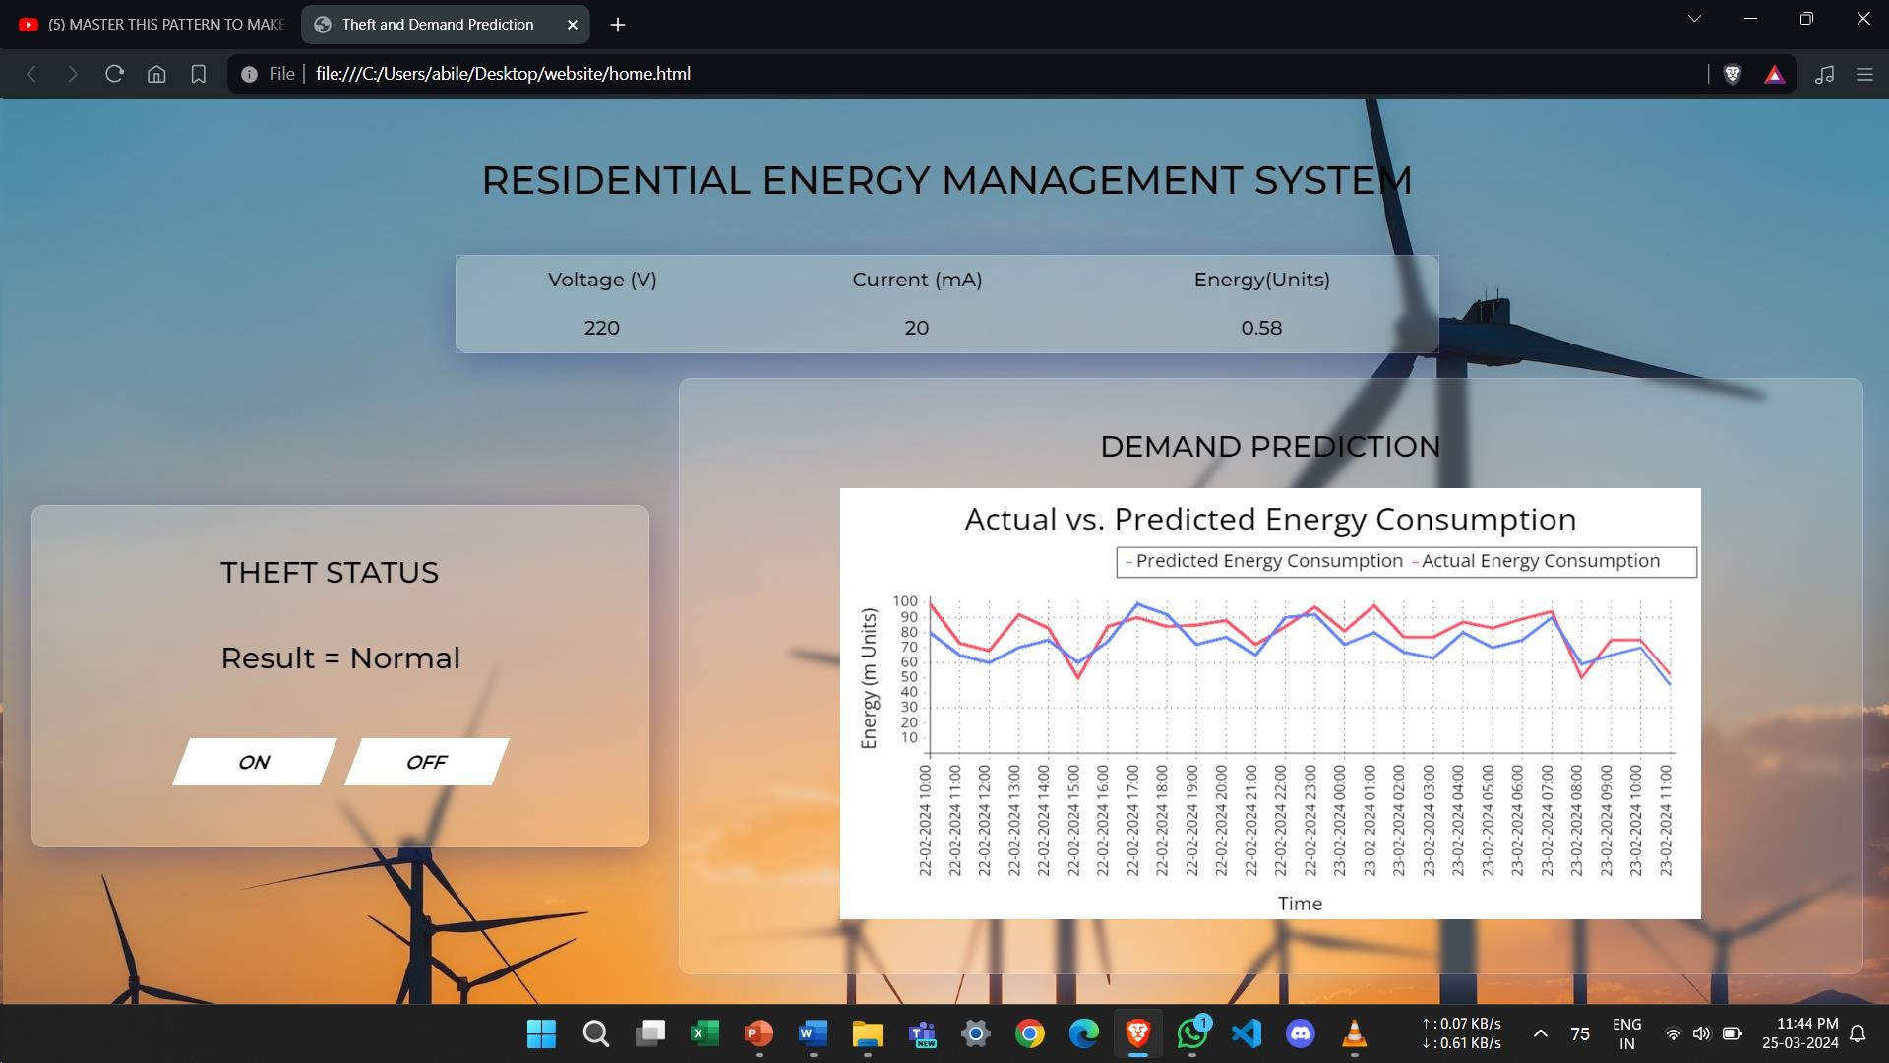
Results of proposed work
WEBSITE DEVELOPMENT FOR USERS :

Slide 19
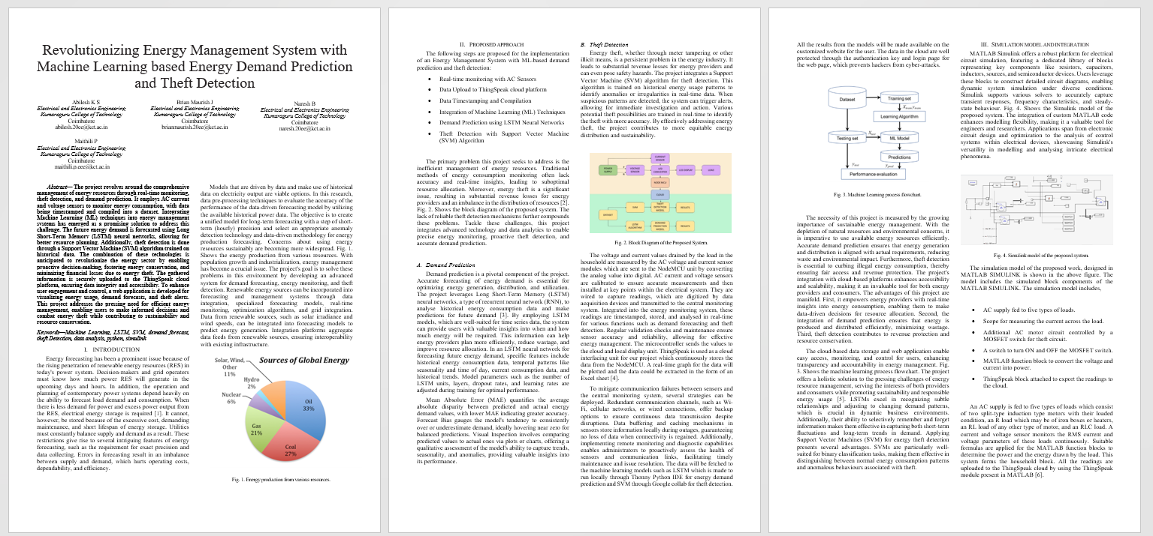
Published Paper

Slide 20


Published paper and plagiarism report

Slide 21
Conclusion
In conclusion, this project presents an integrated system that effectively addresses the critical aspects of energy management, including real-time monitoring, demand prediction, and theft detection.
By combining hardware components and advanced data analytics techniques, it offers a comprehensive solution to energy resource optimization and security challenges, ensuring efficient utilization of energy resources and safeguarding against unauthorized consumption.
This project's contribution to sustainability, efficiency, and accountability makes it a valuable tool for energy providers and consumers in an increasingly energy-conscious world.

Slide 22
References
Nitin K Mucheli,Umakanta Nanda,D Nayak,P K Rout,S K Swain,S K Das,S M Biswal,"Smart Power Theft Detection System",2019 Devices for Integrated Circuit (DevIC)
Rohit Andore,S.S. Kulkarni,A. G Thosar,"Energy Meter and Power Theft Monitoring System",2023 IEEE International Students Conference on Electrical Electronics and Computer Science (SCEECS)
Sumit Mohanty,M. Mohamed Iqbal,Parvathy Thampi M.S.,"Controlling and Monitoring of Power Theft using Internet of Things",2021 International Conference on Design Innovations for 3Cs Compute Communicate Control (ICDI3C)
Sanujit Sahoo,Daniel Nikovski,Toru Muso,Kaoru Tsuru,"Electricity theft detection using smart meter data",2015 IEEE Power & Energy Society Innovative Smart Grid Technologies Conference (ISGT)
Taimur Shahzad Gill,Durr E Shehwar,Hira Memon,Sobia Khanam,Ali Ahmed,Urooj Shaukat,Abdul Mateen,Syed Sajjad Haider Zaidi,"IoT Based Smart Power Quality Monitoring and Electricity Theft Detection System",2021 16th International Conference on Emerging Technologies (ICET)

Slide 23
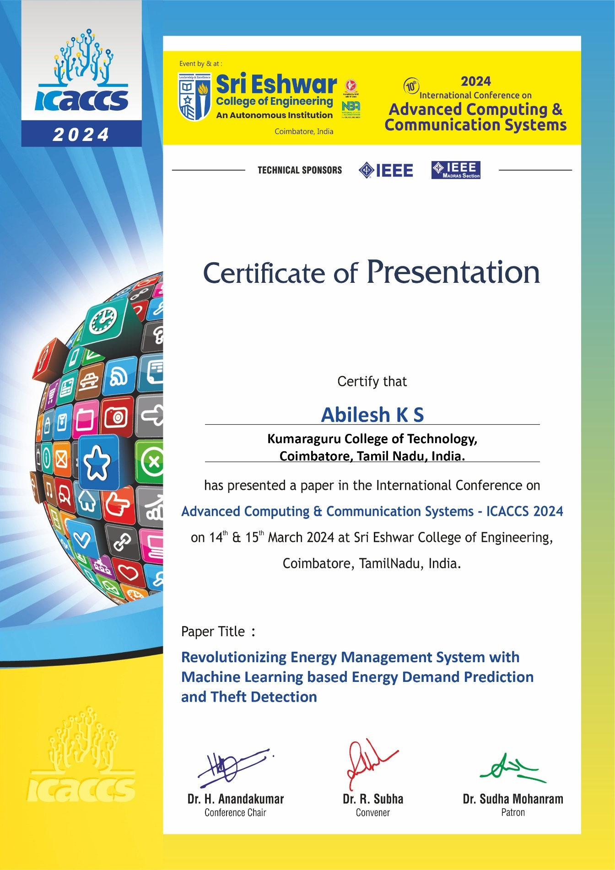


Publication/Hackathon/Patent details

Slide 24
Interaction with Reviewers

